Slide 1
Facial Recognition System
Presented by:
2017UCO1693 – Saahil Hussain Mugloo
2017UCO2192 – Yashasvi

Slide 2
Outline
1. Introduction
2. Face Detection vs Face Recognition
3. How does Facial Recognition work ?
4. Implementation
5. Nodal Points on a Human Face
6. Points of Recognition
7. Facial Recognition Benefits
8. Threats and Concerns
9. Few Applications
10. Conclusion

Slide 3
Introduction
A facial recognition system is a technology used in identifying or verifying a person from a digital image.
It is a category of biometric software that maps an individual's facial features mathematically and stores the data as a faceprint. The software uses deep learning algorithms to compare a live capture or digital image to the stored faceprint in order to verify an individual's identity.
It is also described as a Biometric Artificial Intelligence based application that can uniquely identify a person by analyzing patterns based on the person's facial textures and shape.

Slide 4
FACE DETECTION VS. FACE RECOGNITION
Face detection is a broader term than face recognition. Face detection just means that a system is able to identify that there is a human face present in an image or video. It has several applications like, it can also be used to auto focus cameras, to count how many people have entered a particular area, for marketing purposes etc. For example, advertisements can be displayed the moment a face is recognized.
But the most important applications of face detection is facial recognition. Face recognition describes a biometric technology that actually attempts to establish whose face it is. The process works using a computer application that captures a digital image of an individual’s face and compares it to images in a database of stored records.

Slide 5
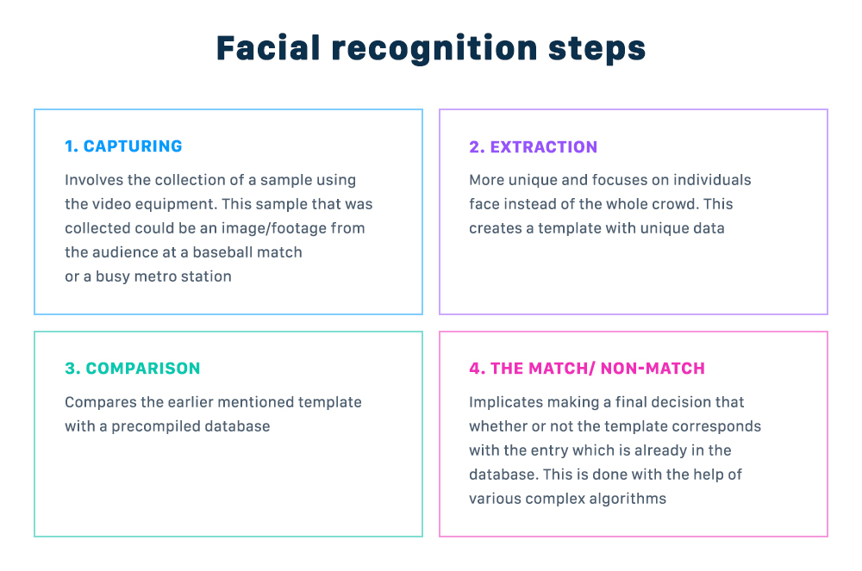
How Does Facial Recognition Work?
The technology systems can vary when it comes to facial recognition, but the general functioning includes following 4 steps:

Slide 6
Implementation
The Eigenface Approach
The procedure is to find the principal components of the distribution of faces. In other words, if each face is treated as a point/vector in a very high dimensional space, we wish to find the eigenvectors of the covariance matrix of a set of said face points/vectors. Each eigenvector corresponds to a single mathematical feature, and can be displayed as an eigenface. A linear combination of all the eigenfaces produces a unique face.

Slide 7
To summarize, we perform the following steps to initialize the system:
Acquire the training image set.
Calculate the eigenfaces from the training set, keep M highest eigenvectors and define the face space. (This step can be repeated when necessary to update face database)
Calculate the weight space spanning M - dimensions for each of the face in the database by projecting their face images onto the face space.
With the initialized system, we can then recognize new face images by:
Calculate a set of weights based on the input image and M eigenfaces by projecting the input image onto each of the eigenfaces.
Calculate the face’s distance to the face space, determine if it is within a preset boundary (determine whether or not it is a face).
If a face is identified, classify it as known or unknown.

Slide 8
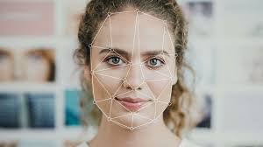
Nodal Points on a human face
Every person’s face has many different peaks and valleys that make up facial features. These peaks and valleys are called landmarks or nodal points. Human face has about 80 nodal points. Some of the nodal points are:
• Distance between the eyes
• Width of the nose
• Depth of the eye sockets
• The shape of the cheekbones
• The length of the jaw line
The nodal points are measured creating a faceprint which is a numerical code that represents the face in the data base.

Slide 9
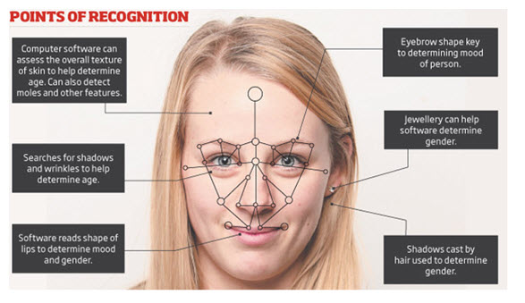

Slide 10
Facial Recognition Benefits
Enhanced security
Faster processing
Seamless integration
Automation of identification

Slide 11
Threats and Concerns
Breach of privacy
Vulnerability in recognition
Massive data storage

Slide 12
Few Applications
# Financial Security
Financial institutions and Banks are using this facial recognition system (FRS) to remove the usual password and PIN protection methods which can be often hacked by theft. This technology can also safeguard vaults and deposit boxes against loots.
# E-commerce
Facial recognition system (FRS) helps verify the identity of shoppers and fastens the shopping and transaction process.
# Surveillance/Scene Analysis
Facial recognition system (FRS) has the ability to extract, and identify non-facial imagery like marks, mask, scars, and tattoos. This technology is capable of identifying a particular person or group of people in a crowd. It is capable of analyzing scenes from archived videos for the precise faces.

Slide 13
# Access Control
It helps identify a person on their identity cards. It eliminates the risk of people using false identity cards.
# Social media
Facebook uses facial recognition software to tag individuals in photographs. Each time an individual is tagged in a photograph, the software stores mapping information about that person’s facial characteristics.
#Authentication as well as identification
Apple’s iPhone X and Xs, for example, include Face ID technology that lets users unlock their phones with a faceprint mapped by the phone's camera.

Slide 14
Conclusion
On one hand, Experiments have revealed that facial recognition technology has high rates of accuracy in terms of facial detection than all other forms of technology and its use is increasing continuously!
It brings immense advantage to the companies and end-users, helps them enhance their security and track down the trespassers.
On the other hand, it may be misused for personal benefit and lead to some serious consequences. Data from a facial recognition system may be captured and stored, and an individual may not even know. The information could then be accessed by a hacker, and an individual’s information spread without ever knowing it. Even worse, a false positive may implicate an individual for a crime they are not guilty of.
Thus, facial recognition is a powerful technology but it has to be used wisely. Laws need to be formulated in complete correspondence with human rights and one’s privacy.

Slide 15
THANK YOU !

